Slide 1



INTRODUCTION OF
COMMUNITY HEALTH NURSING

Slide 2


Slide 3


Slide 4


Slide 5
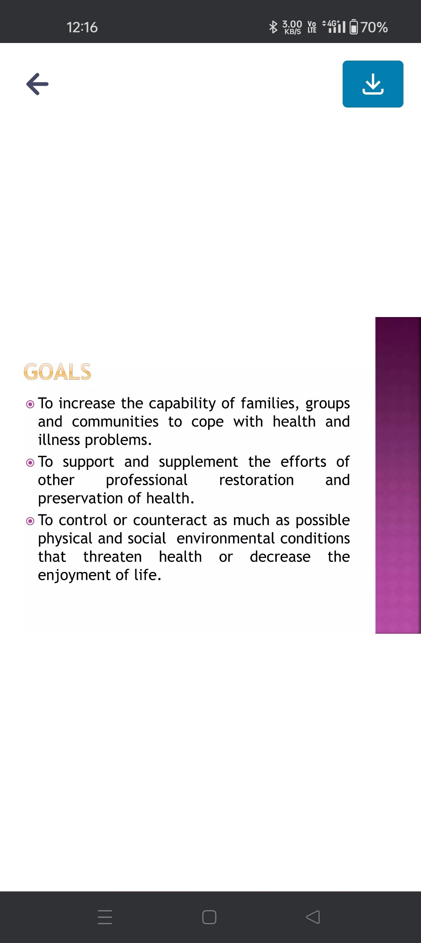

Slide 6
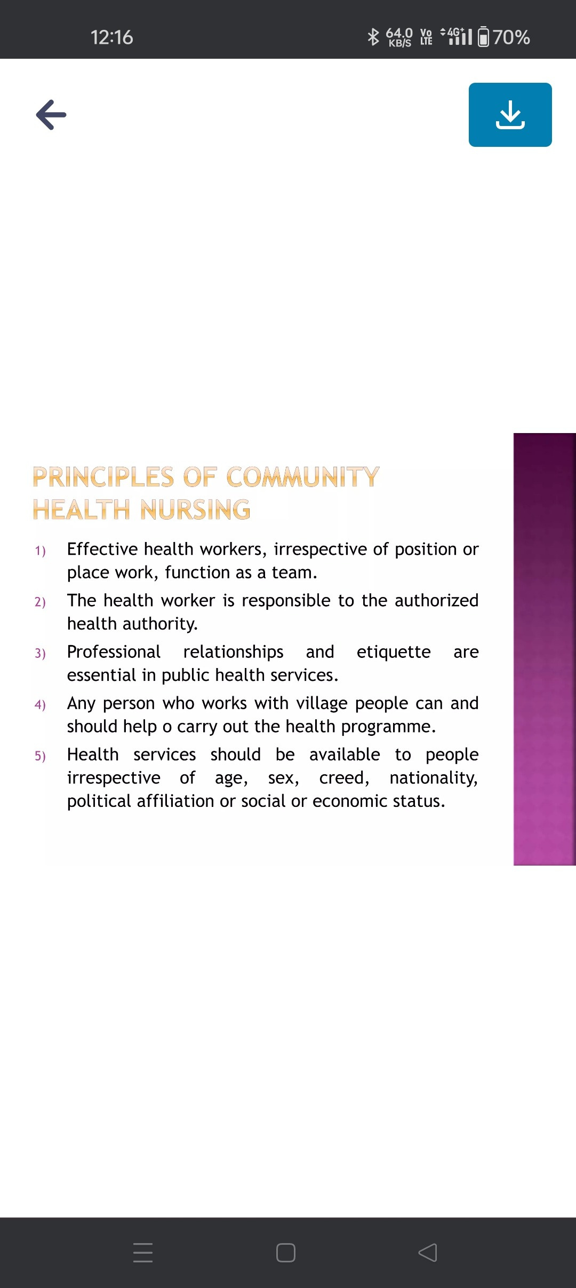

Slide 7
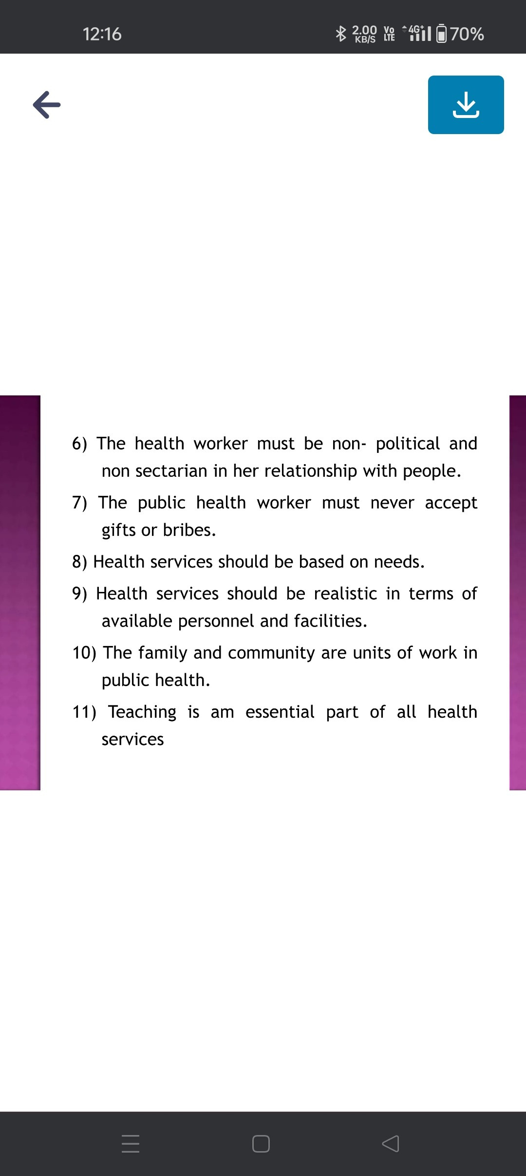

Slide 8
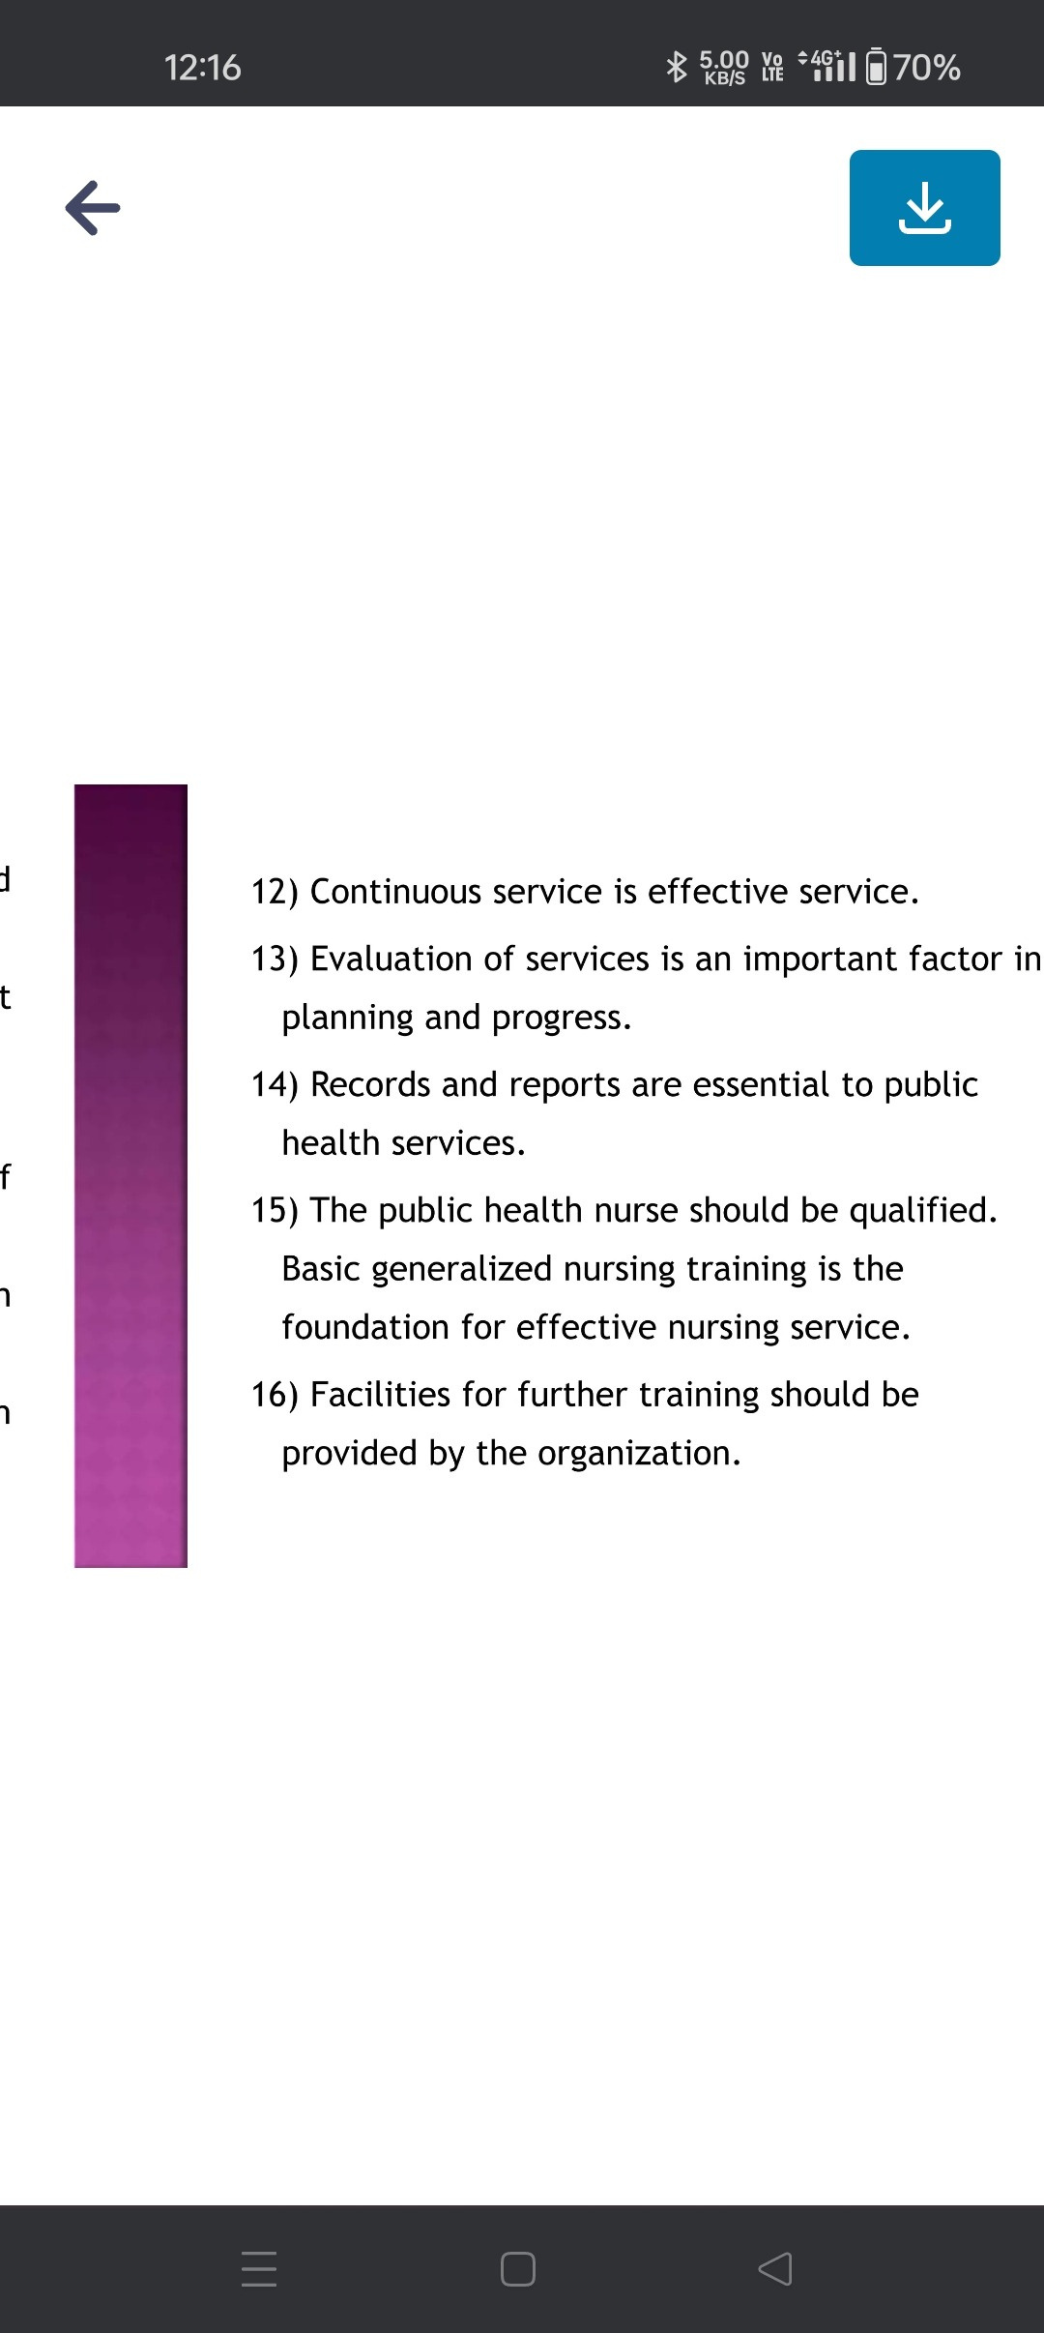

Slide 9


Slide 10
Thank you

