Slide 1
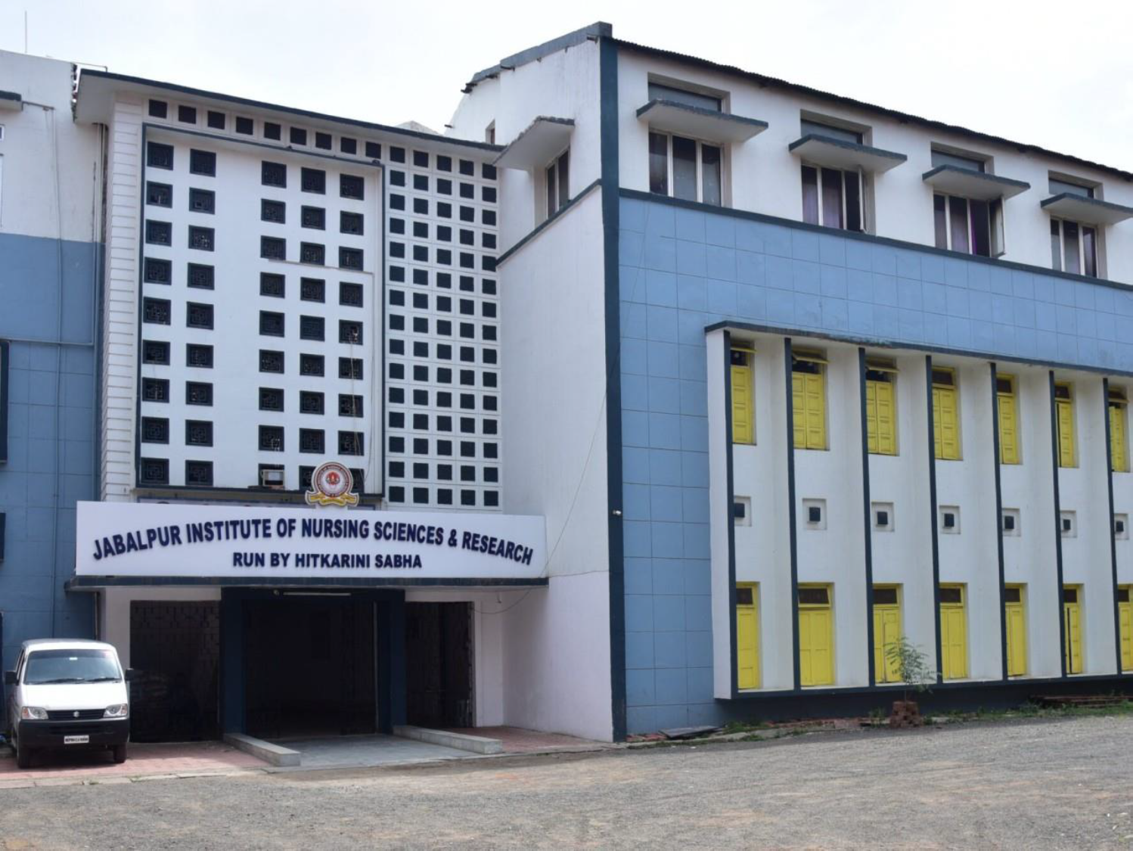

Slide 2
GROWTH AND DEVELOPMENT FROM 7TH MONTH TO 12TH MONTH
MRS.SURBHI ROYNA KEHARI
PROFESSOR
JINSAR

Slide 3
7 MONTHS PHYSICAL OR BIOLOGIC DEVELOPMENT REFLEXES Sucking and rooting reflexes disappear at 7-8 months when asleep. Parachute reflex appears between 7 to 9 months. An infant suspended in a horizontal prone position and lowered suddenly will extend the hands forward to provide protection from falling. This reflex continues indefinitely. TEETHING Upper central incisors erupt (7.5+/-2 months) Lower lateral incisors erupts (7 +/-2 months) Ultimate colds of iris is established.

Slide 4
MOTOR DEVELOPMENT GROSS MOTOR Sits alone on hard surface, leaning forward on hands. Lifts head as if trying to sit up when supine. Control of trunk is more advanced. Rolls more easily from back to abdomen. Sustains all of weight on feet when held in standing position. Bounces actively when held in standing position. FINE MOTOR Holds 2 toys at once. Approaches a toy and grasps it with one hand. Transfers a toy form one hand to the other, usually successfully. Imitates simple acts of others Bangs object that are held. Uses a raking motion to try to obtain small objects. Holds cup.

Slide 5
SENSORY DEVELOPMENT
Head turns in a curving arch to localize sounds.
Depth perception beginning to develop.
Fixates on very small objects and details.
Discrimination between simple geometric forms begins to develop.
Has preferences in taste for foods.
PSYCHOSOCIAL, PSYCHOSEXUAL, SPIRITUAL DEVELOPMENT
PSYCHOSOCIAL
Sense of trust
Shows increasing fear of strangers (7-8 months)
Actively clings to a familiar person when distressed.
Unhappy when caregiver, usually mother, disappears.
Responds socially to own name.
Emotional instability - rapidly changes from crying to laughter.
Closes lips tightly when disliked food is offered.
PSYCHOSEXUAL
Oral stage (0-1 years)
Oral aggressiveness is evidenced by biting and chewing.
Discovers genitalia.

Slide 6
SPIRITUAL
Undifferentiated (0-1 year).
INTELLECTUAL DEVELOPMENT
INTELLECTUAL
Senorimotor stage
Substage III secondary circular reaction (4-8 months.)
MORAL
Pre conventional morality stage 0 (0-2 years)
LANGUAGE, SPEECH DEVELOPMENT
RECEPTIVE LANGUAGE
Recognizes own name.
Responds with gestures to words such as "come"

Slide 7
EXPRESSIVE LANGUAGE
Vocalizes eagerness.
Vocalizes "m-m-m" when crying.
Imitates simple noises and speech sound.
Makes polysyllabic vowel sound.
Vocalizes "do", "ma", "ba"
Babbling decreasing
Some jargon (own language.)
Vocalizes with adult like inflections when others are speaking.

Slide 8
PLAY STIMULATION
Same as 4,5 and 6 months
Place toy under blanked and encourage infant to find it.
Repeat simple sound "dada", "mama"
Provide objects or food that can be bitten and chewed safely.
Continue to encourage playing in water and perhaps "swimming" in shallow tab or pool.
Encourage banging of toys and clapping hands on objects.
Continue to help infant learn balance.

Slide 9
8 MONTHS
PHYSICAL OR BIOLOGIC DEVELOPMENT
Beginning of a pattern in bowel and bladder elimination.
MOTOR DEVELOPMENT
GROSS MOTOR
Sits alone steadily .
Pulls self into standing position with help.
Hand-eye coordination is perfected so that random reaching and grasping no longer occur.
FINE MOTOR
Holds 2 objects while looking at a third.
Persistently reaches for objects beyond range of grasp.
Releases object from hand voluntarily.
Complete thumb apposition.
Pincer grasps beginning to develop, using the fingers against the lover portion of the thumb.
East finger foods, such as crackers, that can be held in one hand.
Drinks from cup with assistance (7-9 months)

Slide 10
SENSORY DEVELOPMENT
Recognizes familiar words and sounds.
PSYCHOSOCIAL, PSYCHOSEXUAL, SPIRITUAL DEVELOPMENT
PHYCHOSOCIAL
Sense of trust, greets strangers with cry or bashful behaviour, turning away, crying or even screaming
Refuses to play with strangers or even accept toys from them
Separation or stranger anxiety, to be distinguished from analytic depression, occurs between 6-8 months, caused by the infants increased capacity to discriminate between family members, close friends and strangers.
Affection for or love of family members appears.
Stretchiness arms to loved family members.
Increased anxiety over loss of parent, especially mother.
Emotional instability still evident.
Dislikes changing clothing and diapers.
PSYCHOSEXUAL
Oral stage (0-1 year).

Slide 11
INTELLECTUAL, MORAL DEVELOPMENT
Sensor motor stage
Sub stage, 3 secondary circular reaction (4-8 month)
Knows that objects are separate from self.
Searches briefly for objects seen being placed elsewhere.
Actions to produce a result have been memorized.
Sub stage 4 , coordination of secondary schemes (8-12 month)
Abilities learned earlier are combined and extended to deal with new situations: behavioural and perceptual patterns are coordinated and applied to new situations.
Object permanence: progresses and is related to the increasing ability to deal with matters of time and space.
Perceptions of space become refined between 8-12 months.
Beginning perception of cause and effect relationship.
Early beginning of anticipatory and intentional behaviour.
Problem solving beginning to develop.

Slide 12
MORAL
Pre conventional morality stage 0 (0 - 2 years)_
LANGUAGE, SPEECH DEVELOPMENT
RECEPTIVE LANGUAGE
Stops activity when own name is spoken.
Beginning to understand meaning of "no"
EXPRESSIVE LANGUAGE
Shouts for attention.
Imitates sound sequence.
Continues syllables: "da- da", "ma-ma" (non specific meaning).
Con vocalize consonants, d, t and w,

Slide 13
PLAY STIMULATION
Hold, touch and rock infant gently.
Talk and sing to infant.
Place infant a sitting position against a wall and encourage leaning away from the wall to improve balance.
Gently push infant from a sitting position to improve balance.

Slide 14
9 MONTHS
PHYSICAL OR BIOLOGIC DEVELOPMENT
REFLEXES- planter grasp absent.
TEETHING- upper lateral incisors erupt (9+/-2 months).
MOTOR DEVELOPMENT
GROSS MOTOR
Raises to a sitting position alone with good coordination.
Sits steadily for longer period of time.
Recovers balance when leaning forward, but not sideways.
Craws instead of hitching, when crawling the infant is prone, the abdomen touches the floor, the head and solders are supported by the Elbows. The body is pulled along by the movement of the arms while leg movements may resemble swimming or kicking motions.
Creeping- thins is a more advanced type of locomotion than crawling the trunk is carried above the floor, but parallel to it, the infant uses both hands and knees in moving forward.
Beginning to pull self to standing position alone while holding on to furniture.

Slide 15
FINE MOTOR
Bangs two objects together.
Pokes objects with fingers.
Uses thumb and index finger in early pincer grasp.
Has preference for the use of one dominant hand.
Holds own bottle with good hand-mouth coordination. Puts nipple in add withdraws it from mouth at will.
Drinks from cup with some spilling (9-12 months).
Attempt to use a Spoon but spills contents.
SENSORY DEVELOPMENT
Head turns directly to source of sound.
Increased depth perception.
Recognizes by looking or moving toward familiar object when named.
Able to follow objects through transition from one place to another.

Slide 16
10- 12-month .
Weight: average gain of about 13 ounces each month, birth weight is doubled at approximately 4 to 5 months and tripled at one year • Height: average growth of just over 1/2 inch each month with most infants growing 10 inches in the first year. • Head size: average growth of about 1/2 inch each month
Be 3 times their birth weight
Grow to a height of 50% over birth length
Have a head circumference equal to that of their chest
Have 1 to 8 teeth
Stand without holding on to anything
Walk alone or when holding one hand
Sit down without help
Bang 2 blocks together
Turn through the pages of a book by flipping many pages at a time
Pick up a small object using the tip of their thumb and index finger
Sleep 8 to 10 hours a night and take 1 to 2 naps during the day

Slide 17
SENSORY AND COGNITIVE DEVELOPMENT
The typical 12-month-old:
Begins pretend play (such as pretending to drink from a cup)
Follows a fast moving object
Responds to their name
Can say momma, papa, and at least 1 or 2 other words
Understands simple commands
Tries to imitate animal sounds
Connects names with objects
Understands that objects continue to exist, even when they can't be seen
Participates in getting dressed (raises arms)
Plays simple back and forth games (ball game)
Points to objects with the index finger
Waves goodbye
May develop an attachment to a toy or object
Experiences separation anxiety and may cling to parents
May make brief journeys away from parents to explore in familiar settings

Slide 18
Milestones
Enjoys listening to songs
Explores toys with hands, fingers, and mouth
Crawls to or away from objects baby sees in the distance
communication
Meaningfully uses “mama” or “dada”
Responds to simple directions, e.g. “Come here”
Produces long strings of gibberish (jargoning) in social communication
Says one or two words
Imitates speech sounds
Babbling has sounds and rhythms of speech
Pays attention to where you are looking and pointing
Responds to “no”
Begins using hand movements to communicate wants and needs, e.g. reaches to be picked up
Is interested in interacting with others, e.g. peek a boo

Slide 19
PLAY AND SOCIAL SKILL
Maintains eye contact with people during playful interactions
Raises hands to be picked up
Turns head in response to name being called
Points to objects of interest by 12 months
Enjoys playing with toys of varied textures
Enjoys playing and banging musical toys
Enjoys various types of movement, such as being gently swung in the air by parents
Frequently explores the environment when placed on floor

Slide 20
PLAY
You can help your 12-month-old develop skills through play:
Provide picture books.
Provide different stimuli, such as going to the mall or zoo.
Play ball.
Build vocabulary by reading and naming people and objects in the environment.
Teach hot and cold through play.
Provide large toys that can be pushed to encourage walking.
Sing songs.
Have a play date with a child of a similar age.
Avoid television and other screen time until age 2.
Try using a transitional object to help with separation anxiety.

Slide 21
Conclusion
The development of an infant and young child can be quite complex. Every child is born into a distinct atmosphere and the child must then learn to adjust and adapt to this atmosphere. Some children may be at a disadvantage because of a lack of involvement and attention from parents or caregivers. Every parent has their own parenting style, which can have a substantial and lasting impression on the child’s development. As the child begins pre-school or kindergarten, he or she must once again learn to adapt to a new environment apart from their home lives. Within this educational atmosphere children continue to develop socially and cognitively as they begin to interact with classmates and peers on a regular basis. No two children develop in the same way. Varying parenting styles, family values, home environments, and educational environments can have an influence on how a child grows and develops between infancy and early childhood.

