Slide 1
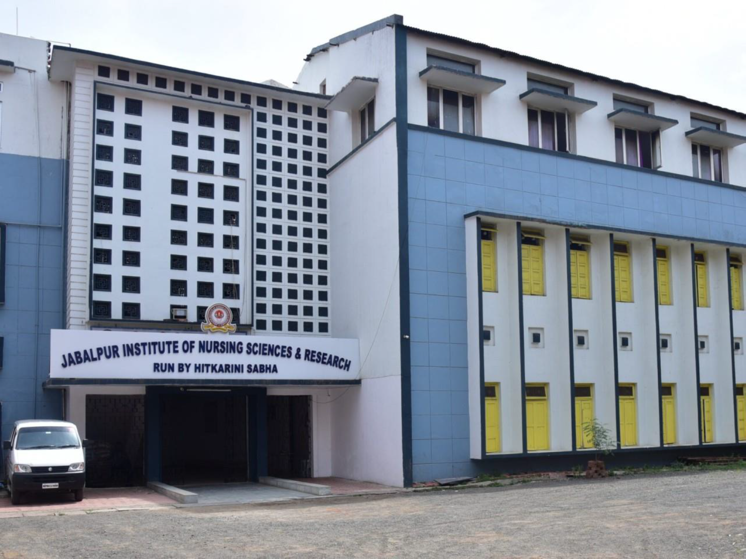

Slide 2
GROWTH & DEVELOPMENT PRE SCHOOL CHILDREN FROM 3YRS TO 5YRS
MRS.SURBHI ROYNA KEHARI
PROFESSOR
JINSAR

Slide 3
GROWTH & DEVELOPMENT (3 YEARS):
Physical and biological development:
Weight: - approximately 12.5-16.5 kg
Height: -approximately 90.5-101.5 cm. has increased 8cm
Pulse: - 105 15 beats per minute
Respiration: - 25 5 per minute
Blood pressure: - 100/60 20
Usually dry at night

Slide 4
Motor development:
Gross motor:
Walks a straight line
Walks backward
Walks on tip toes
Runs without looking at feet
Catches ball with extended arms
Kicks a ball
Rides tricycle using pedals; turns wide corners.
Fine motor:
Builds a tower of 9-10 blocks
Copies a circle
Uses blunt scissors with one hand to cut
Shows preference for hardness
Puts beads on string
Can help with simple household tasks

Slide 5
Self-care:
Dressing skills:
Can put on coat without assistance
Can undress self in most instances.
Toileting & grooming skills:
Can put pants up & down
Can go to toilet alone
Brushes teeth with help.
Sensory development:
Visual acuity 20/20

Slide 6
Psychosocial development:
Sense of initiative (3-5 years)
Egocentric – unable to see others view point and can’t understand why others don’t see child.
Tends to be in patient and selfish
Usually separate easy from parents
Physically and verbally aggressive
Still have fears
Dreams and night mares continues
Sexually curious
Demonstrate strong attachment for parents with opposite sex.
Psychosexual development:
Phallic stage (3-6 years)

Slide 7
Spiritual development:
Intuitive – projective faith
Moral development:
Pre- operational stage-
Sub stage I (2-4years): pre conceptual
Sub stage II (4-7 years): Intuitive stage
Characteristics of thought include animism & realism
Able to follow directional commands
Has a beginning understanding of time.
Tries to please and conforms to request the characteristics of thought include animism and realism.

Slide 8
Language development
Receptive language
Can obeys two prepositional commands
Expressive language
Uses 4- word sentences- asks why, uses plurals
Give sex and full name figures in a pictures
Has vocabulary of 800-1000 words
Child should be intelligent 90% of time
Play stimulation:
Likes things that squish, move, talk, make noise
Books about known things, crayons, paints, climbing apparatus
Transportation toys , tricycle, wagons, dump trucks, doll carriage
Play telephone, single puzzles, toy dishes, soap bubbles

Slide 9
GROWTH & DEVELOPMENT (4YEARS):
Physical or biologic development:
Weight: -Approximately 13.5-19.5 kg. Has gained weight during fourth year (2.27kg)
Height: -Approximately 95-10
Pulse: -100 10 beats per minute
Respiration: - 24 4 per minute
Blood pressure: -100/60 20
Usually dry at night

Slide 10
Motor development:
Gross motor:
Runs on tip toes
Balances on one foot 3-5 seconds
Jumps from greater heights
Pedals a tricycle quickly; turns sharp corners.
Catches balls with extended arms and with hands.
Hops on preferred foot
Climbs ladders, trees, playground equipment.
Alternative feet when descending stairs.

Slide 11
Fine motor:
Copies a square
Draws a simple face.
Cuts around pictures with scissors.
Able to follow directional commands.
Has a beginning understanding time.

Slide 12
Self-care: -
Feeding skills-
Manages spoon with little spilling
Eats with fork held in fingers
Dressing skills-
Buttons side buttons, small buttons
Can put on socks with help
Put on shoes without help.
Toileting & grooming skills-
May bathe self with assistance
Washes and dries hands without supervision
Sensory development-
Visual acuity 20/20

Slide 13
Psychosocial development-
Sense of initiative (3-5 years)
Egocentric – unable to see others view point and can’t understand why others don’t see child.
Tends to be in patient and selfish
Usually separate easy from parents
Physically and verbally aggressive
Still have fears
Dreams and night mares continues
Sexually curious
Demonstrate strong attachment for parents with opposite sex.
Psychosexual development:
Phallic stage (3-6 years)
Spiritual development:
Intuitive – projective faith

Slide 14
Moral development:
Pre- operational stage:
Sub stage I (2-4years) pre conceptual
Sub stage II (4-7 years) egocentric
Classify object according to one characteristics
Not able to conserve matter
Continues to believe thought cause events.
Obeys because parents set limit, not because of understanding between right and wrong.
Highly imaginative.
Concept of time improving, especially in relation to sequence of daily routine.
Uses alibis to excuse behavior.
Pre- conventional Morality-
Stage-2 (4-7 years)
You do it for me; I’ll do it for you.

Slide 15
Play stimulation-
Play cooperatively with others.
Interested in world.
Provide: hand puppets, doll house & furniture, costume box, doll nurse or doctor kit to stimulate imagination, black board, chalk, paste, paper, scissors, clay, finger, paints to stimulate creativity.
Sliding boards, swings, work bench, blocks of all sizes, garden toys. Tinker toys to encourage motor activities.

Slide 16
GROWTH & DEVELOPMENT (5 YEARS):
Physical or biologic development:
Weight – approximately 15.4- 21.4 kg gained 2.27kg during the fifth year.
Height – approximately- 103-115 cm. gained 8 cm (3 inch) in fifth year.
Pulse 95 15 (average 90 beats/ minutes)
Respiration 22 3 per minute
Head size- adult size nearly reached
Anticipate immediate toilet needs.

Slide 17
Motor development
Gross motor:
Skips, alternative feet’s.
Jumps rope and jumps over objects
Walks a balance beam
Imitates dance steps if taught
Catch a ball smoothly with hands.
Balances on one foot 8-10 seconds
Roller stakes
Fine motor:
Copies a triangle
Crosses vertical lines
Copies letters; may be able to print own name
Draws a three part man

Slide 18
Self-care:
Feeding skills-
Select fork over spoon when appropriate.
Dressing skills-
May able to lace shoes.
Manages zippers in back.
Toileting & grooming skills:
Wipes self independently
Flushes toilet after stools.
Bathes self
Coombs hair will help.
Can blow nose when asked.
Sensory development
Visual acuity- 20/20

Slide 19
Psychosocial development:
Sense of initiative (3-5 years)
Continues to be egocentric separates easily from parents independent and trust worthy
Looks for parents encouragement and support
Engages in cooperative play.
Very industrious
Approximately related to adult outside family.
Psychosexual development:
Phallic stage- (3-6 years)
Spiritual development
Intuitive- projective faith

Slide 20
Moral development:
Pre-operational thought-
Sub stage II (4-7 years)
Classifies object according to relationship that are similar.
Accurately describes events.
Aware of cultural difference
Matter of fact about differences in others
Time orientation improving using words with increased meaning.
Very curious

Slide 21
Language development:
Receptive language-
Carries out instruction with three suggested tasks i.e. wash, dry. Sit down
Expressive language-
Names primary colors
Ask meaning of words
Repeat sentences of 10-12 syllables
Counts to 10
Has a vocabulary of 2100 words.

Slide 22
Play stimulation-
Plays competitive, excessive games
Loves to transport thing in truck, cars and wagons.
Provide: simple games for competitive & team play (see- saw, jungle gym, jump, role and skates for motor activity.
Construction toys, paper dolls, opportunities for collecting nature specimen for creative activity.
Color sets, books and puzzles for quiet play.
Immunization-
Booster dose of OPV (Oral polio vaccine), TT (Tetanus Toxoid), DPT ( Diphtheria, Pertussis, Tetanus)
Dentition: -
Changes in dentition are few during the pre-school years. Preschool child should visit a dentist regularly every 3-6 months. Dental caries are most common during this period.
Health promotion: -
The nurse is responsible for assisting the parents in understanding the changes that occur in appearance, skills and behavior of pre-school child.
In addition parents need guidance in health promotion, accident prevention and health supervision.

Slide 23
Nutrition-
Preschoolers need to eat only one half as much as does the adult. The daily requirement of calorie ranges from 1300-1700 calories includes 30 grams of protein. Water requirement decreases to 90-100 ml/kg/day.

Slide 25
Play stimulation-
The progress that pre-school children make in personality development, ability to deal with reality and control of feelings can be seen in their play. Through play children learn to express their feelings through and develop love and concern for their play mates.
Characteristics of play-
Play is the business of children.
Pre- school children play actively.
They climb, runs, hammer, open doors with a bang and slam them shut.
Develop motor skills require practice for progressing improvement.
Children are always aware of the differences between real and their imaginary world.
Children need to be encouraged to express their own creativity rather than fitting them with in a mold of adult expectation.
They should be encouraged to play with toys of their own choice independent of gender role.

Slide 26
Sleep pattern-
Sleep pattern vary widely but the average pre-school child sleeps approximately 12 hours at night and infrequently takes daytime naps.
Walking during the night is common throughout early childhood and may rarely than developmental factors.
Exercise-
Motor activity continues to be high and allow pre- school child to explore their environment, begin learning physical games, sports and interact with others.
Pre –school child increased gross motor abilities and coordination provide them the opportunity to engage in many physical activity.

Slide 27
CONCLUSION-
Parents are still responsible for the health care and health supervision of their preschool children. The health care provider should share information on the developmental needs of preschool child as well as respond to the concerns of parents. Giving parents their child health records or at least a list of the problems, current information on nutrition, increases participation in the learning – teaching situation. It is important today for the parents / child/ family to be active participants in their own health care.

