Slide 1


JABALPUR INSTITUTE OF NURSING SCIENCES AND RESEARCH
SUBJECT: COMMUNITY HEALTH NURSING
TOPIC: REVISED NATIONAL
TUBERCULOSIS CONTROL PROGRAMME
PRESENTED BY: ARNICA JOSEPH
NURSING TUTOR
J.I.N.S.A.R

Slide 2

Revised National Tuberculosis Control Program
The National TB Programme (NTP) was started in 1962 for TB control in India. This programme was not able to give expected results in India
The NTP was reviewed in 1992.
As a result of the review and pilot studies in 1993, the DOTS strategy was adopted in India under the Revised National TB control Programme – RNTCP
The programme was implemented in a phase manner and by 24ᵗʰ March 2006, the entire country was covered under the programme
Notes:
2

Slide 3
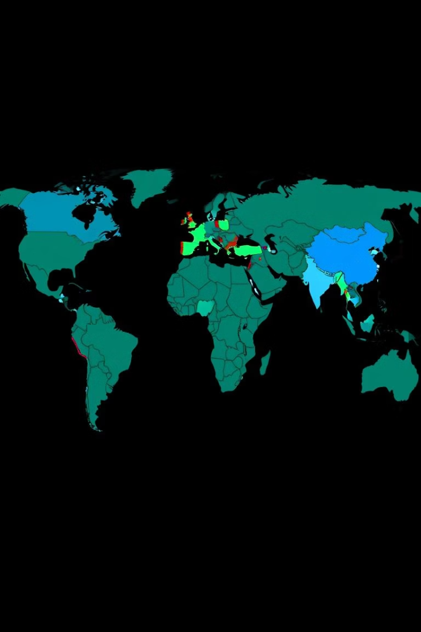
Burden of Tuberculosis: Global and National Perspective
10M
1.5M
Global Cases
Global Deaths
Approximately 10 million people fall ill with TB each year worldwide.
TB remains a leading cause of death, claiming 1.5 million lives annually.
26%
India's Share
India accounts for 26% of the global TB burden, making it a critical focus area.
Notes:
3

Slide 4

Goals and Objectives of the Revised Program
1
Reduce Incidence
Decrease new TB cases significantly.
2
Reduce Mortality
Lower TB-related deaths.
3
Achieve Elimination
Work towards TB elimination by 2025.
4
Improve Patient Care
Ensure equitable and accessible quality care.
Notes:
4

Slide 5
Key Components of the Revised Program
Enhanced Surveillance
Active Case Finding
Universal Drug Susceptibility Testing
Patient-Centric Care
Proactive efforts to detect hidden cases.
Holistic support for improved adherence and outcomes.
Robust data collection and analysis for better insights.
Timely diagnosis for effective treatment plans.
Notes:
5

Slide 6




Strengthening Case Detection and Diagnosis
Advanced Diagnostics
Utilizing molecular tests for faster, accurate detection.
Active Case Finding
Door-to-door screenings in high-risk areas.
Expanded Services
Increasing access to diagnostic facilities.
Notes:
6

Slide 7

Improving Treatment Outcomes and Patient Support
Directly Observed Treatment (DOT)
Nutritional Support
Providing food supplements to patients for better recovery.
Ensuring medication adherence through supervision.
Counseling Services
Addressing psychological and social challenges faced by patients.
Notes:
7

Slide 8





Fostering Partnerships and Community Engagement
Government Agencies
Private Sector
Community Leaders
NGOs
Engaging private healthcare providers for extended reach.
Partnering with non-governmental organizations for grassroots efforts.
Collaborating with various ministries and departments.
Mobilizing local support and awareness.
Notes:
8

Slide 9








Strengthening Surveillance and Monitoring
Data Collection
Analysis & Reporting
Gathering comprehensive TB data from all sources.
Generating insights for program adjustments.
Early Warning
Mapping Trends
Detecting outbreaks and unusual patterns swiftly.
Identifying high-burden areas and emerging hotspots.
Notes:
9

Slide 10
Thank you
Notes:
9

