Slide 1
PHYSIOLOGICAL CHANGES DURING PREGNANCY
PART II
Mrs. REENA MATHEW
ASSO. PROFESSOR
OBG DEPT
JINSAR

Slide 2
Purpose –
Anatomical + Physiological + biochemical adaptation
Stimuli – fetus
Can be misinterpreted as disease or may mask or worsen pre-existing disease
Lab values –abnormal – physiological anemia-misnomer
Virtually every organ system affected
Can touch almost any specialty

Slide 3
Learning Objectives
- To know the normalphysiological changes in various systems of the body during pregnancy
Anatomical changes in genital organs
Skin changes
Changes in breast
Weight gain
Cardiovascular changes
Hematological changes
- Learners should be able to differentiate them from pathological conditions
- Learners should be able to differentiate these changes from any pathological condition.

Slide 4
METABOLIC CHANGES
Water metabolism
Carbohydrate, Protein and Fat metabolism
Mineral metabolism – Iron and calcium

Slide 5
WATER METABOLISM
Water retention ~ 6.5 lit
Causes
1. osmo-regulation
2. Estrogen & Progesterone
3. Control by vasopressin
Pitting edema on ankles & legs, at the end of a day Causes
1. Rise in venous pressure due to IVC compression
2. Fall in interstitial colloid osmotic pressure

Slide 6
CARBOHYDRATE METABOLISM
Glucose needed throughout pregnancy by fetus Insulin secretion is increased in response to glucose
Sensitivity of Insulin receptor decreased in later months of pregnancy
Plasma insulin increased due to contr-insulin factors- E, P, hPL, cortisol, prolactin, FFA
Continuous supply of sugar maintained
Mild fasting hypoglycemia due to fetal consumption, Postprandial hyperglycemia & hyperinsulinemia due to anti-insulin factors
OGTT may show abnormal pattern

Slide 7
PROTEIN & FAT METABOLISM
PROTEIN METABOLISM
+ nitrogen balance
Pregnancy is anabolic state
Fetus + Placenta – 500gm protein
Uterus, breast & blood – 500gm
Aminoacid – active transport
FAT METABOLISM
Storage of fat – during midpregnancy
3-4kg of fat stored in abdominal wall, breasts, hips & thighs
Plasma lipids, liprotein level rise due to E, P, leptin & hPL

Slide 8
MINERAL METABOLISM
IRON AND CALCIUM

Slide 9
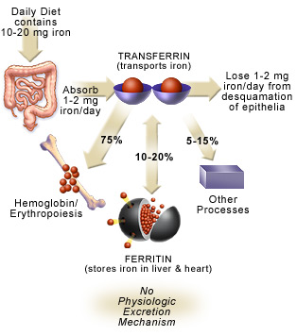
IRON METABOLISM
Iron – absorbed in ferrous form
Site – duodenum & jejunum
Released in circulation – transferrin
Active transport across placenta
Storage iron - ferritin
Iron requirement – 2nd half in last 12 weeks

Slide 10
IRON METABOLISM
IRON STORES – 2 gm of total iron content in women, only 300mg iron stores
IRON NEEDED – 1000mg in pregnancy→[300mg transferred to fetus, placenta, 200mg lost, rest 500mg in RBC]
Red cell volume – 350ml (1ml = 1.1mg iron)
Saving of 300 mg of iron due to amenorrhea for 10 months (30mg/cycle is lost with menses)
All iron used in latter half of pregnancy, so the iron requirement during 2nd half→ 6-7mg/day
Diet and stores are inadequate to meet this demand inspite of increased absorption from gut

Slide 11
Serum ferritin level ~ body iron stores
In absence of supplementation – serum iron & ferritin level fall and so also Hb & PCV falls
Pregnancy –inevitable iron deficient state
But fetus never becomes deficient
Average blood loss with Normal delivery-500-600 ml,
C-section, normal twin delivery -1000ml

Slide 12
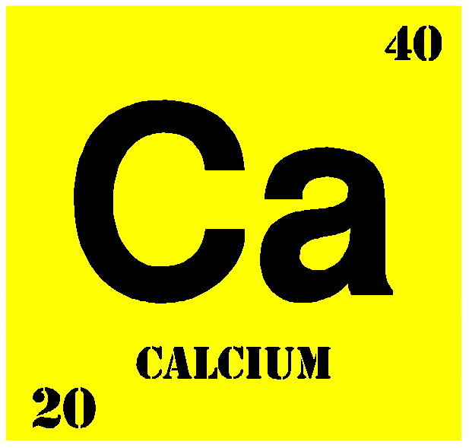
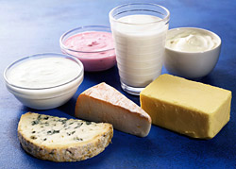
CALCIUM METABOLISM
Demand of calcium increases -28gm, 80% in 3rd trimester
Daily requirement – 1-1.5gm
Calcium absorption from intestine and kidneys are doubled due to rise in 1,25dihydroxy vitD3
Total calcium levels fall but serum ionised level is unchanged.

Slide 13
RENAL SYSTEM
Kidney
Ureter
Bladder

Slide 14
KIDNEY
Kidney – dilatation of ureter & renal pelvis
Kidney enlarges by 1 cm
Renal plasma flow – increase by 50-75%, max at 16 wks
GFR – increased by 50%
Reduction in maternal serum Creatinine, BUN and uric acid.
Renal tubule fails to absorb – glucose, amino acid. vitamins

Slide 15
URETER
Atonic – progesterone
Dilatation of ureter above pelvic brim with stasis
Right > left, Primigravida > multi
Cause – 1. dexrorotation of uterus – presses right ureter against pelvic brim. 2. pressure of right ovarian vein which crosses right ureter at right angle
Stasis marked – 20-24 wks
Elongation, kinking & outward displacement of ureters.

Slide 16
BLADDER
Marked congestion with hypertrophy
Late pregnancy – mucosa edematous due to venous & lymphatic obstruction ( primi – early engagement)
Frequency of micturation
Stress urinary incontinence.

Slide 17
PULMONARY SYSTEM
Elevation of diaphragm – enlarged uterus → diaphragmatic breathing
Subcostal angle, transverse dmt, chest circumfereance increases.
Mucosa of respiratory tract – congestion & hyperemia
Hyperventilation → increase tidal volume – due to progesterone acting on respiratory centre → shortness of breath.
Also – changes in acid base balance → PaCO2 falls(38 to32) & PaO2 rises(95-105) → facilitates CO2 transfer from fetus to mother and O2 transfer from mother to fetus.
Pregnancy – state of respiratory alkalosis ( pH rises – base excess)

Slide 18
GIT CHANGES
Morning sickness – hyperemesis gravidarum
(weight loss, ketonemia and electrolyte imbalance)
Dietary craving: pica
Decreased gastrointestinal motility: Constipation, early satiety
Diminished gastric secretion, delayed emptying time – risk of peptic ulcer is reduced.
Relaxation of LES - reflux and heartburn
Liver, Gallbladder function, - cholestasis, stones
Hyperemia and softening of the gums (epulis)
Hemorrhoid
Appendix displaced

Slide 19
CENTRAL NERVOUS SYSTEM

Slide 20
CNS
Nause, vomiting, mental irritability, sleeplessness – psychological effect
Postpartum blues, depression, psychosis seen in susceptible women
Parasthesia in hands, arms, thigh
Compression of nerves – median nerve, lateral cutaneous nerve of thigh.

Slide 21
ENDOCRINE CHANGES
Pancreas
  Carbohydrate metabolism -Insulin resistance
    Human placental lactogen, cortisol
Thyroid Function
  Increased TIBG (via liver)
  Increased total T₄ and T₃
    free levels unchanged
    HCG suppresses TSH
Adrenal function
  Free plasma cortisol is elevated
    CRH from placenta stimulates ACTH

Slide 22
Immunology
Must adapt to accept ‘allograft’
Immune response altered, but not deficient
Modulates away from cell-mediated cytotoxic effects
  Progesterone effect
  NK cells decrease by 30%
  Enhanced humoral / innate immunity
    Immunoglobulins still active
    IgG crosses placenta
  More susceptible to CMV, HSV, Varicella, Malaria
  Decrease in symptoms of some autoimmune disorders

Slide 23
Pregnancy – not a disease
Profound changes in physiology and anatomy
Affects most organ systems
Can dramatically impact disease states, susceptibility, and treatment
Almost all will encounter and treat pregnant women
  Even if you don’t know it
Under-appreciation of changes will lead to suboptimal treatment or outright mistakes

Slide 24
Summary
We have studied about the physiological adaptations in body during normal pregnancy

Slide 25
REFERENCES –
-Williams textbook of obstetrics
-D.C.Dutta’s textbook of obstetrics

Slide 26
EXAM APPAERED QUESTIONS-
Cardiovascular changes in – 4marks
Hematological and renal changes in pregnancy-4marks
Carbohydrate intolerance-4 marks
Iron metabolism-4 marks
Isthmus and lower uterine segment-4 marks

Slide 27
THANK YOU…

