Slide 1
PHYSIOLOGICAL CHANGES DURING PREGNANCY Part 1
Mrs. REENA MATHEW
ASSO. PROFESSOR
OBG DEPT
JINSAR

Slide 2
Purpose –
Anatomical + Physiological + biochemical adaptation
Stimuli – fetus
Can be misinterpreted as disease or may mask or worsen pre-existing disease
Lab values –abnormal – physiological anemia-misnomer
Virtually every organ system affected
Can touch almost any specialty

Slide 3
Learning Objectives
- To know the normalphysiological changes in various systems of the body during pregnancy
Anatomical changes in genital organs
Skin changes
Changes in breast
Weight gain
Cardiovascular changes
Hematological changes
- Learners should be able to differentiate them from pathological conditions
- Learners should be able to differentiate these changes from any pathological condition.

Slide 4
General Principles
Most changes begin early
Even before pregnancy recognized
Most are hormonally driven
Progesterone, estrogen, renin / aldosterone, cortisol, insulin
Some ‘mechanically’ driven
Designed to optimize conditions for fetus & prepare for delivery
Delivery of oxygen & nutrients

Slide 5
They are physiological changes, that is, they are entirely normal, and
It include cardiovascular, hematologic, metabolic, renal and respiratory changes that become very important in the event of complications.
The body must change its physiological and homeostatic mechanisms in pregnancy to ensure the fetus is provided for.

Slide 6
GENITAL TRACT
Cervix, Vagina
Ovaries, Uterus

Slide 7
Cervix, Vagina, Ovaries
Cervix – Softening [Goodell’s sign] blue color, vascularity, edema, hypertrophy/plasia of glands, mucus plug, bloody show at term, Less than optimal Pap smear
Vagina – vascularity, hyperemia [Jacquimier’s sign] copious secretion, acidic pH 3.5-6 [ lactic acid from glycogen by LB] → protects against infection.
Ovaries – Ovarian cycle suspended so no uterine cycle and no menses → due to Estrogen & Pregesterone, Growth & persistence of corpus luteum till 8wks then regress

Slide 8
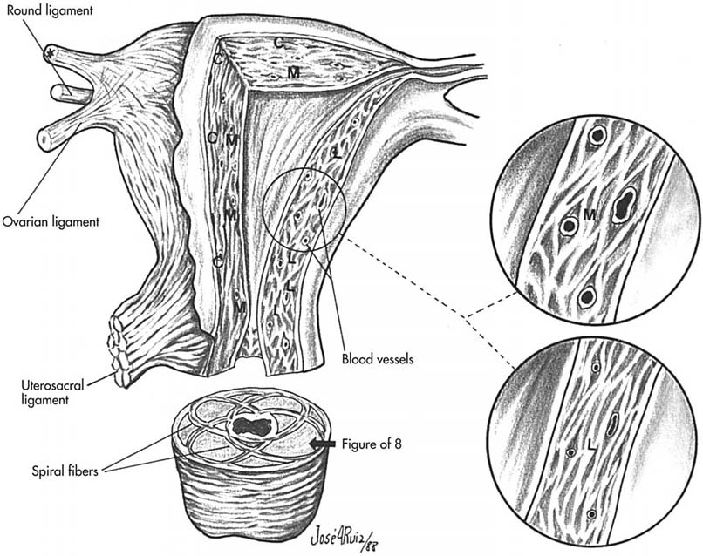
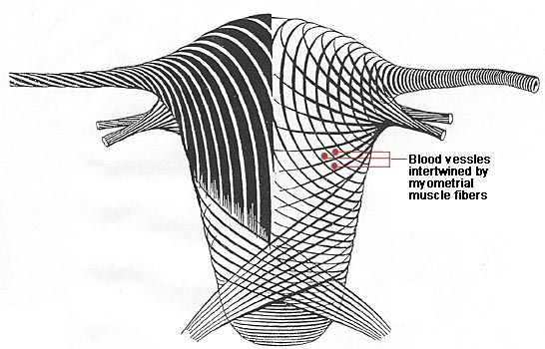
UTERUS
Enlargement - Hper-plasia+trophy upto 12 wks & stretching after 20 wks [ estrogen induced]
7.5cm→35cm, 50gm→1kg
Arrangement of muscle fibres -
outer – longitudinal,
inner – circular,
intermediate – criss-cross fashion like figure of 8

Slide 9
Uterus
Living ligatures
Fundal enlargement marked.
Shape: Pear(NP) → Globular(12wks) →ovoid / pyriform (28wks) →spherical 36wks.
Dextro-rotation of uterus
Braxton-Hicks contraction – irregular, infrequent, sporadic, unpredictable, nonrhythmic, variable intensity, no effect on cervical dilatation

Slide 10
Uteroplacental blood flow
- Uterine vessels
- Ovarian vessels

Slide 11
ISTHMUS
Structural & functional changes.
Ist trimester – hypertrophy & elongation →3 times.
Circular muscle fibres acts as sphincter – retain fetus
Incomepetency – mitrimester abortion

Slide 12
Lower uterine segment
Lower uterine segment forms from isthmus in late pregnancy.

Slide 13
CERVIX
Stroma – hypertrophy –plasia of elastic & connective tissue
Vascularity is increased – blue color
Glandular hyperplasia & hypertophy
Marked softening of cervix (6wks) – Goodell’s sign
Diagnostic as well as facilitates dilatation during labor.
Copious secretion – leucorrhea – due to progesterone – mucus plug

Slide 14
SKIN
Pregnancy mask/melasma gravidarum
Linea nigra → MSH
Striae gravidarum
Striae albicans
Vascular spider } Estrogen
Palmer erythema } “

Slide 15
SKIN

Slide 16
BREAST
Primi > multi
Size increases – proliferation of ducts & alveoli
Myoepithelial cells
Axillary tail –enlarge,painful
Montgomery tubercle
Secondary areola
Seceretion – 12th wk, colostrum

Slide 17
WEIGHT GAIN

Slide 18
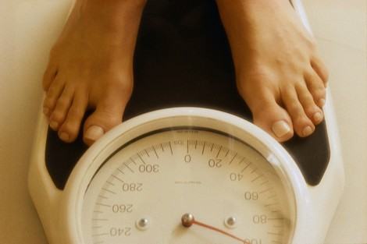
Weight Gain
Early pregnancy- wt loss
Progressive till last 2 wks
Total wt gain -11kg(24lb)
1st-1kg, 2nd-5kg, 3rd-5kg
Periodic & regular weight checking must
Rapid wt gain->0.5kg[1lb]/wk or >2kg[5lb]/month in 3rd trimester ->pre-eclampsia
Stationary or falling wt → IUGR, IUD
Ideal wt gain-BMI
Normal 20-26→11-16kg Obese >29→7kg, Underweight <19→18kg

Slide 19
Distribution of weight
Reproductive weight gain – 6 kg
Fetus – 3.3 kg
Placenta – 0.6 kg
Liqour – 0.8 kg
Uterus - 0.9 kg
Breast – 0.4 kg
Net maternal weight gain – 6 kg
Blood volume – 1.3 kg
ECF – 1.2 kg
Fat & protein – 3.5 kg

Slide 20
CARDIOVASCULAR SYSTEM
Heart & Circulation

Slide 21
Anatomical changes
Cardiac output
Blood pressure – arterial & venous
Supine hypotension syndrome
Regional distribution of blood flow

Slide 22
Anatomical changes
Elevation of diaphragm due to enlarged uterus –
Heart is pushed upwards & outwards with slight rotation to left

Slide 23
Clinical finding
Palpitation
Apex beat – shifted to 4th IC space, 2.5 cm outside MCL
Pulse rate – slight rise
Systolic murmur – apical/pulmonary area – decreased blood viscosity & torsion of great vessels.
Continuous hissing murmur – tricuspid area – left 2nd/3rd ICS – Mammary murmur – increased blood flow thru internal mammary vessels
Third heart sound – rapid diastolic filling, 4th HS – rare
ECG – left axis deviation

Slide 24
Cardiac output
Increases from 5th week → peak 30-34 weeks ( 40-50%)
Then remains static till term
C.O – lowest – sitting/supine position, highest – lateral position
C.O increases further during labor (+50%) & after delivery (+70%) – squeezing out of blood from uterus into maternal circulation.
C.O returns to pre delivery labor values by 1 hour following delivery & to the pre-pregnant level by another 4weeks time
Cause of increased C.O – 1. Increased BV 2. Increased metabolic activity to meet O2 demand
Increased stroke volume and pulse rate – 15beat/min
Normal heart can cope up with increased load.

Slide 25
Arterial blood pressure
Product of cardiac output and systemic vascular resistance.
Diastolic BP falls more than SBP (overall fall 5-10mmHg)
Position when B.P taken – important
BP is lowest in lateral position
In clinic – sitting position & korotkoff’s 5 sound should be considered.
Korotkoff’s 4 sound – only if 5 occurs at 0 mmHg
Best with sphygmomanometer than automated BP monitor as it overestimates DBP.
In suspected pre-eclamtic women – automated monitor is inaccurate at higher BP

Slide 26
Venous pressure
Antecubital venous pressure – unaffected
Femoral venous pressure – raised in later month
It is due to pressure exerted by gravid uterus on common illiac veins, more on the right side due to dextrorotation
NP – 8-10 cm of water → 20 cm of water – lying down & 80-100cm in standing position.
Physiological edema of pregnancy subsides by rest alone
Distensibility of the vein & stagnation of blood in venous system – edema, varicose veins, piles & DVT.

Slide 27
Supine hypotension syndrome
Late pregnancy – gravid uterus compresses on IVC in supine position
This results in opening up of collateral circulation by means of paravertebral & azygous veins
In 10% - collateral circulation fails to open up so the venous return to heart falls → hypotension, tachycardia & syncope
Normal BP can be quickly restored by turning the patient to lateral position
This does not happen in labor as contraction of uterus increases venous return.

Slide 28
Clinical implication of supine hypotension syndrome
Epidural or spinal anesthesia – ability to maintain normal BP may be lost in supine position.
Effects of maternal positioning on cardiac output is important – hypotensive women & nonreactive NST.
Prolonged standing – low birth weight & placental infarct.

Slide 29
Signs & Symptoms of Normal Pregnancy that may Mimic Heart Disease
Signs
Peripheral edema
JVD
Symptoms
Reduced exercise tolerance
Dyspnea
Auscultation
S3 gallop
Systolic ejection murmur
Chest x-ray
Change in heart position & size
Increased vascular markings
EKG
Nonspecific ST-T wave changes
Axis deviation
LVH

Slide 30
HEMATOLOGICAL CHANGES

Slide 31
HEMATOLOGICAL CHANGES
Blood volume –raised in pregnancy- from 6wk→40-50% max at 30-32 wks, static later till term
Plasma Volume – Rises parallel to blood volume- 50% seen more in twin pregnancy & large baby
RBC- 20-30% Hb- 18-20%
Disproportionate to plasma volume →apparent fall in Hb due to hemodilution.

Slide 32
HEMATOLOGICAL CHANGES
Advantage of relative hemodilution –
1. Less viscosity-optimum gaseous exchange
2. Protects mother from adverse effects of blood loss at delivery
Neutrophilic leucocytosis-10-15,000/cumm, 20,000 in labor due to estrogen & cortisol

Slide 33
BLOOD CHANGES
 | Non prgnant | Pregnant at term | Total increment | Change
Bld volume | 4000ml | 5500ml | 1500ml | +30-40%
Plasma vol | 2500ml | 3750ml | 1250ml | +40-50%
RBC [ml] | 1400 | 1750 | 350 | +20-30
Hb [gm] | 475 | 560 | 85 | +18-20
PCV | 38% | 32% |  | Falls

Slide 34
Total protein
 | Non pregnant | Pregnancy near term | changes
Total protein(gm) | 180 | 230 | increased
Plasma protein conc ( gm/100ml) | 7 | 6 | decreased
Albumin Globulin | 4.3 2.7 | 3 3 | decreased slight increase
A/G Ratio | 1.7: 1 | 1:1 | decreased

Slide 35
Blood coagulation

Slide 36
Blood coagulation factors
Pregnancy – hypercoagulable – risk of thrombo- --embolic disease
Fibrinogen – Raised from 200-400mg% →300-600 mg%
All clotting factors [xcept factor 11 & 12] 10, 9, 8,7 and 2 are increased, but Clotting time remains unchanged
Fibrinolytic activity is depressed till 15 min after delivery
Platelets – conflicting picture [ static or fall ]
Effective control of blood loss and hemostasis after placental seperation

Slide 37
Clinical implication
Increased risk of venous thromboembolism both during pregnancy and the puerperium.
The risk of thromboembolism is ~ 2 times normal during pregnancy and
Increases to 5.5 times normal during the puerperium.
Understanding these physiologic changes is necessary to manage two of the more serious problems of pregnancy - hemorrhage and thromoembolic disorder, both caused by disorders in the mechanism of hemostasis.

Slide 38
Summary
We have studied about the physiological adaptations in body during normal pregnancy

Slide 39
Questions:
SAQ:
Cardiovascular changes during pregnancy-4marks
Hematological changes during pregnancy-4marks

Slide 40
REFERENCES –
-Williams textbook of obstetrics
-D.C.Dutta’s textbook of obstetrics

Slide 41
Thank you

